Slide 1

CRS
CAR RENTAL SYSTEM
Bhupinder Manhas
Suriyaraj dhanasekaran
Han ZHOU
jianing XU
NANDA KUMAR
VINAY CHANDRA

Slide 2
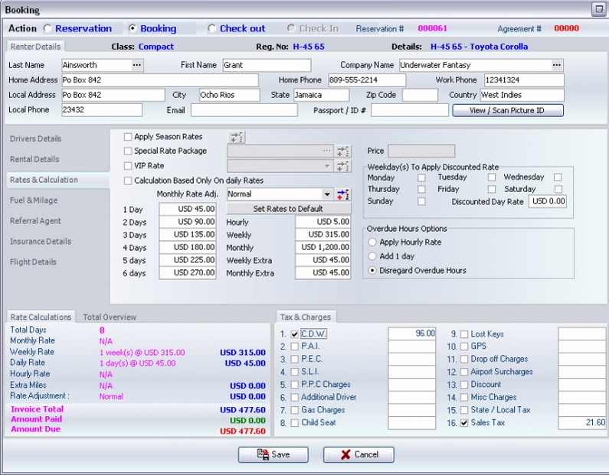
MOTIVATION
Complicated
Training time
Documentation
Prone to errors

Slide 3
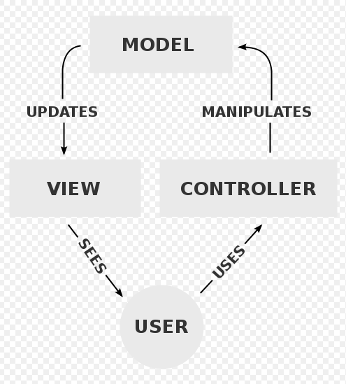
IMPLEMENTATION
Desktop
Java
JavaFX
Scenebuilder
MySQL
Navicat
Webserver
PHP
MySQL
HTML/CSS
Javascript
MVC

Slide 4
SE ENGINEERING

Slide 5
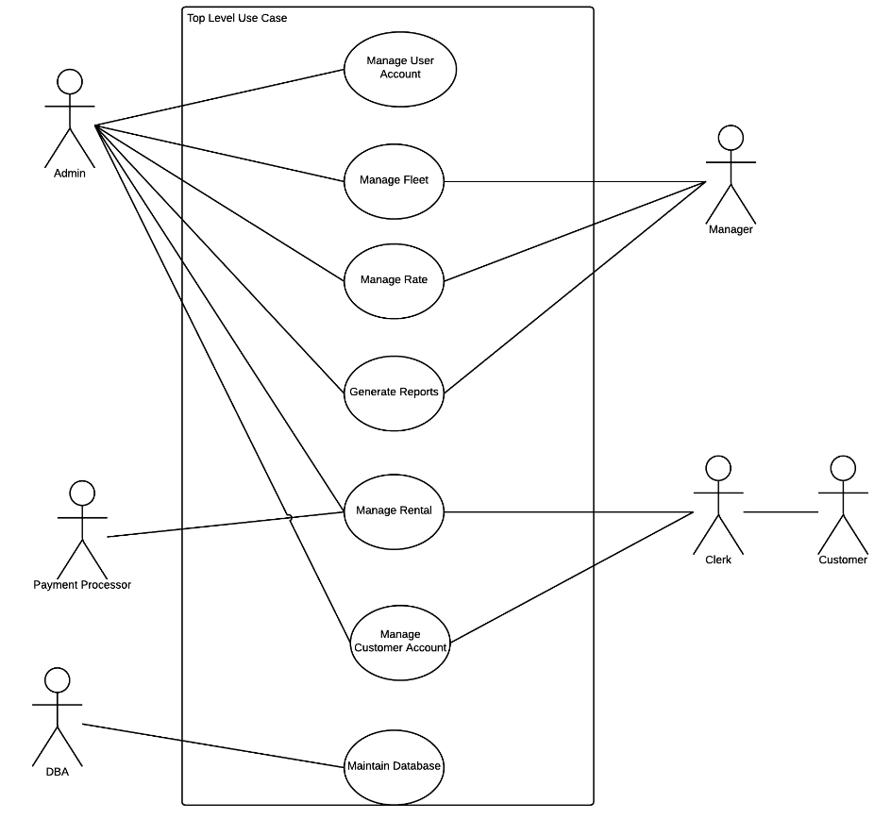
USE CASES

Slide 6
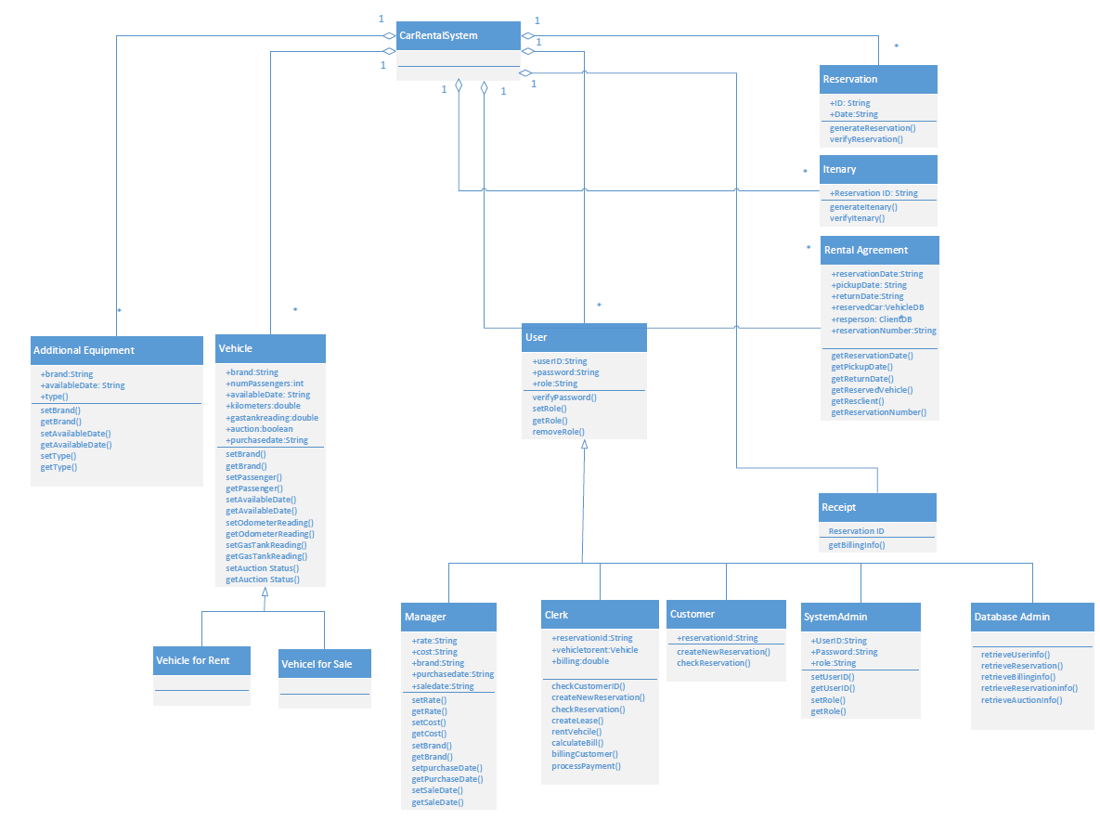
MVC
CLASS DIAGRAM

Slide 7
DBMS

Slide 8
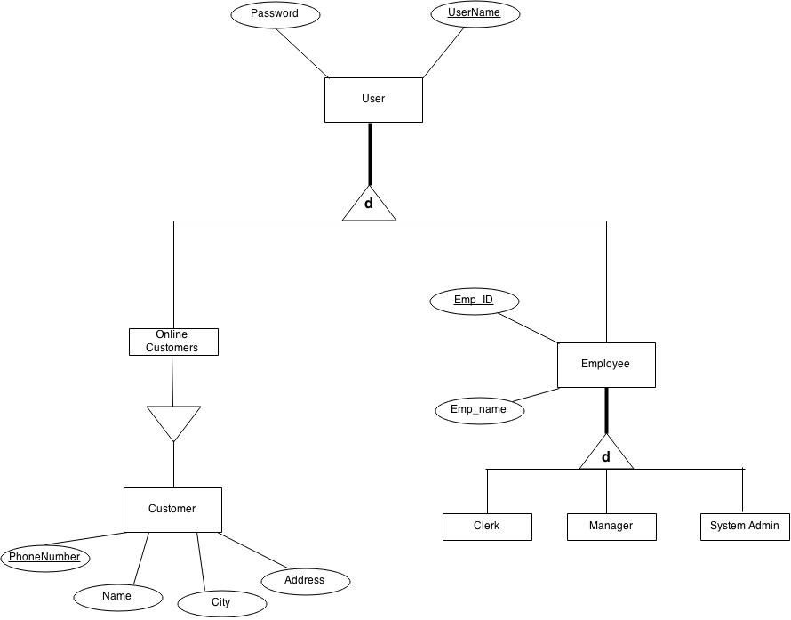
ER 1

Slide 9
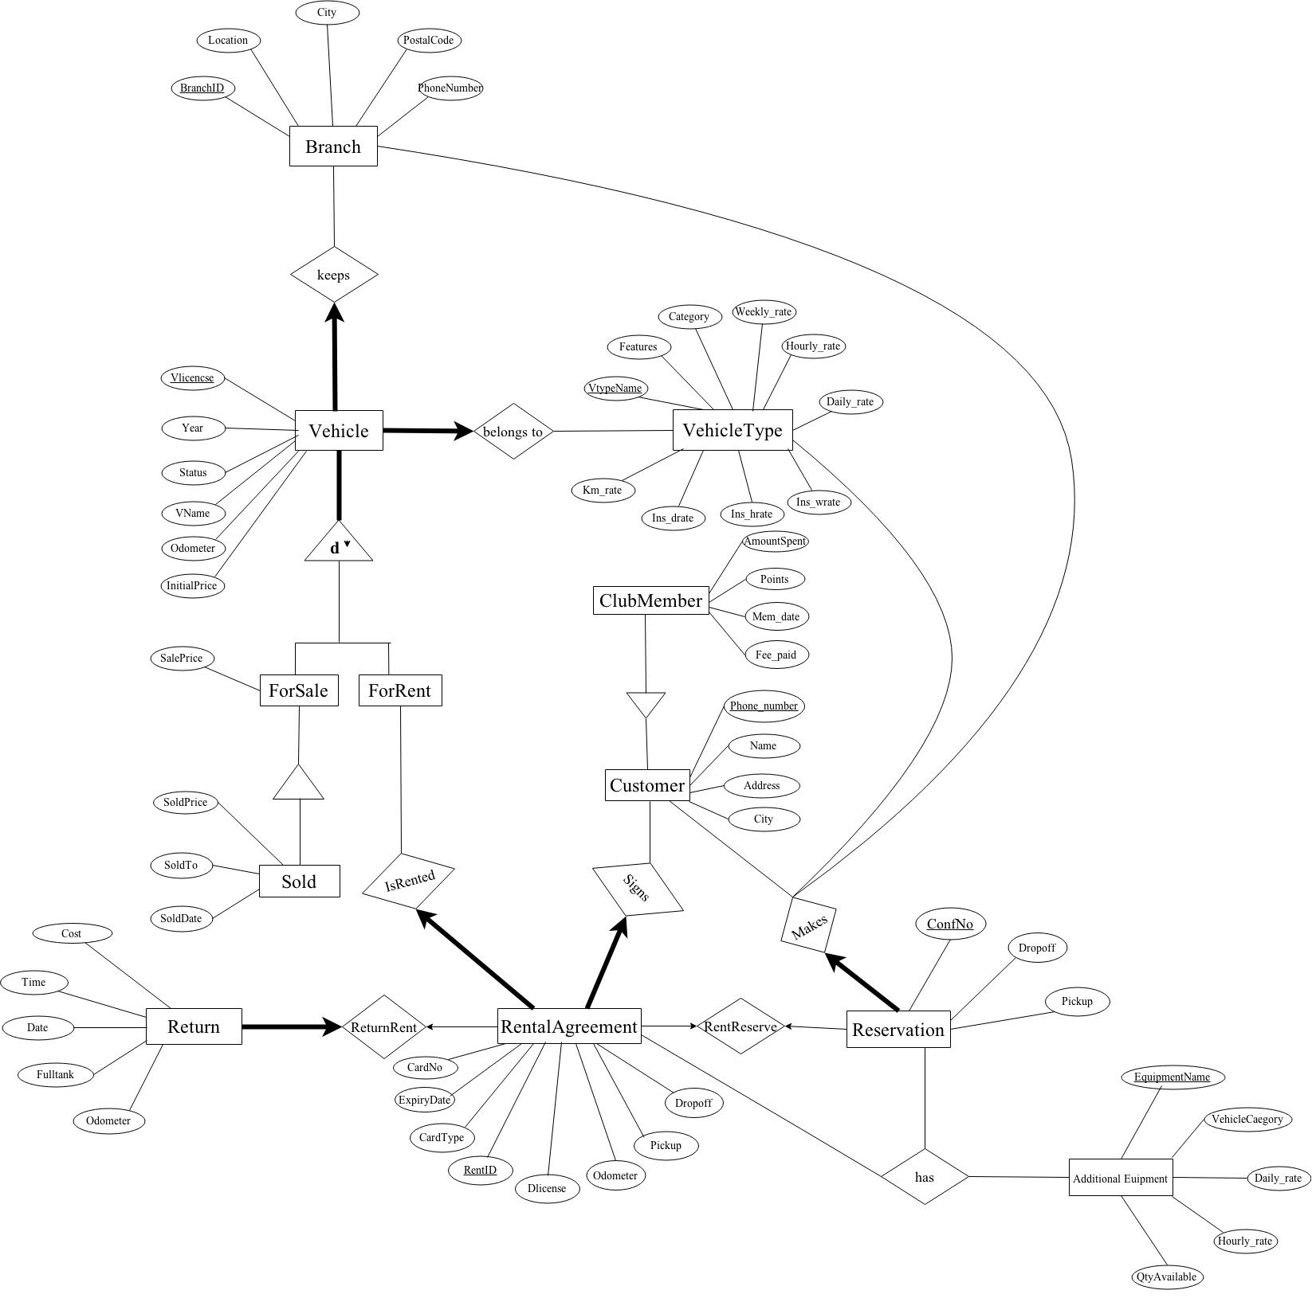
ER 2

Slide 10
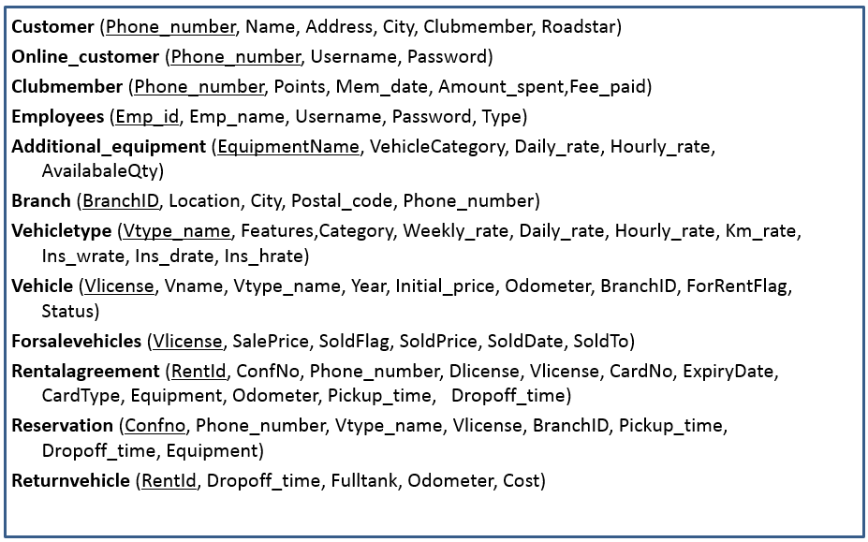
FINAL SET OF TABLES

Slide 11
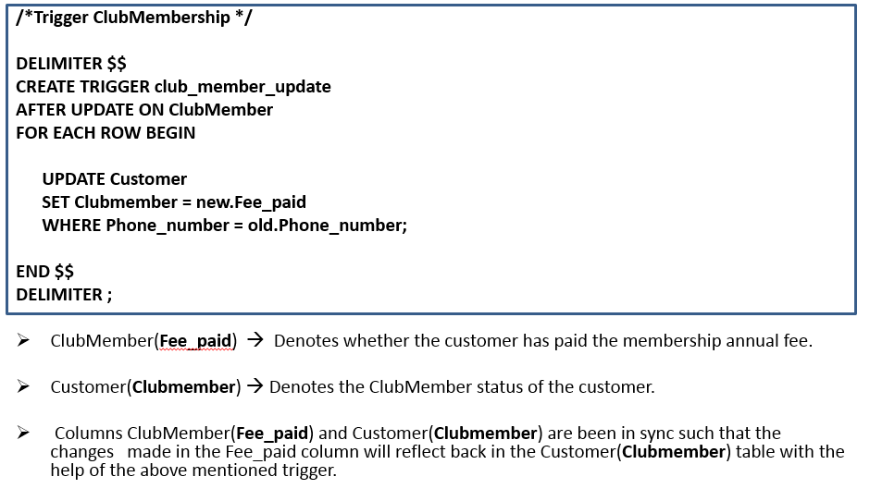
RENEW MEMBERSHIP

Slide 12
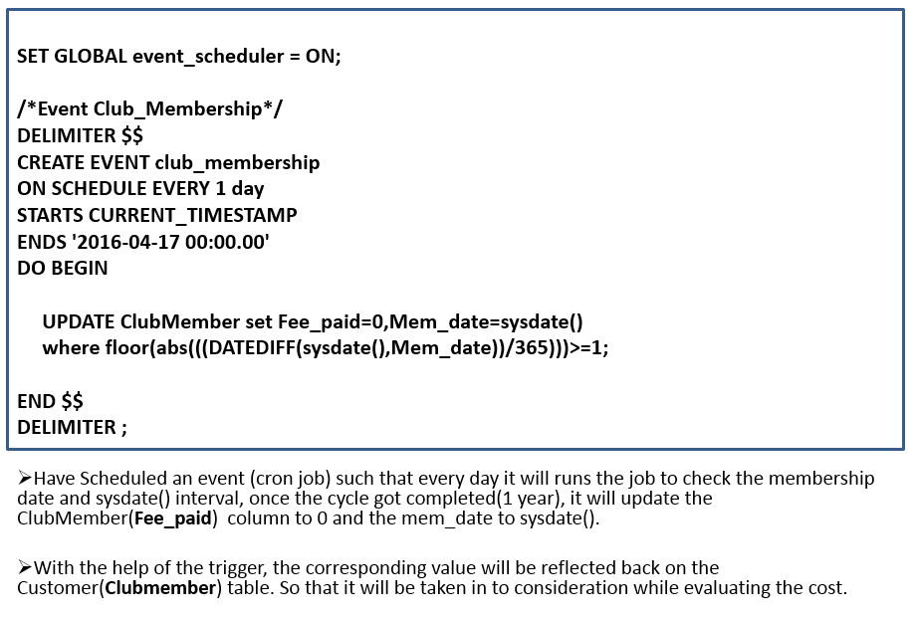
CRON JOB

Slide 13
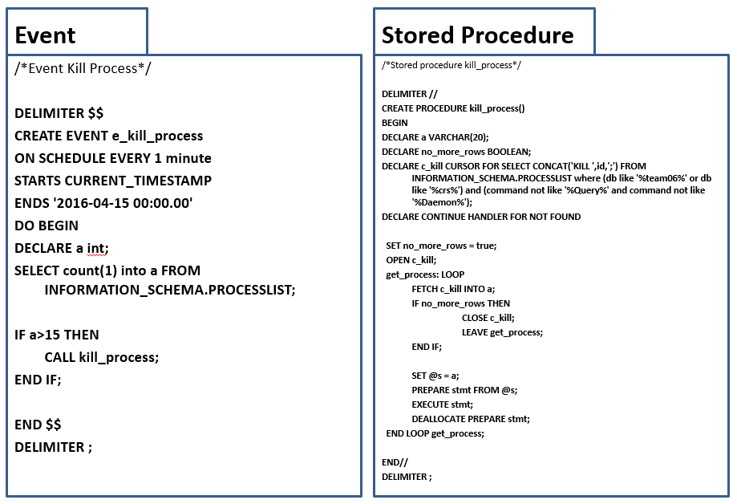
ACTIVE CONNECTIONS

Slide 14
DEMO

